Slide 1
Contemporary Moral Problems
M-F12:00-1:00SAV 264
Instructor: Benjamin Hole
Email: bvhole@uw.edu
Office Hours: everyday after class

Slide 2

Agenda
Introduction
Where we are
Review Writing Assignment Three
Clicker Quiz
Finish Kant
Start Mappes

Slide 3
Week | Required Reading | Assignment
Course Mechanics, Theory Primer, and Philosophical Argumentation 6/23-6/27 | Benjamin Hole, Phil 102 Syllabus Lewis Vaughn (posted on website), “How to Read an Argument” Mark Timmons, “Moral Theory Primer” | WA1, due 6/27
Philosophical Writing and Ethical Theory 6/30-7/3 (Holiday, 7/4) | Mark B. Woodhouse (posted on website), “How to Write Philosophy” James Rachels (posted on website), “The Challenge of Cultural Relativism” Jeremy Bentham (posted on website), “The Principle of Utility” Robert Nozick, “The Experience Machine” (posted on website) | None
Ethical Theory 7/7-7/11 | J.S. Mill (electronic), On Liberty, Chapters 1-2 Immanuel Kant (posted on website), “The Moral Law” | WA2, due 7/8
Introduction to Sexual Ethics 7/14-7/18 | Thomas Mappes, “A Liberal View of Sexual Morality and the concept of Using Another Person” The Catholic Church, “Vatican Declaration on Some Questions in Sexual Ethics” John Corvino, “A Defense of Homosexuality” | None
Introduction to International Ethics 7/21-7/25 | Peter Singer, “Famine, Affluence, and Morality” (posted on website) Garrett Hardin, “Lifeboat Ethics” (posted on website) | WA3, due 7/22
Introduction to Social and Political Ethics: Censorship and Pornography 7/28-8/1 | Ronald Dworkin, “Liberty and Pornography” Judith M. Hill, “Pornography and Degradation” Catharine MacKinnon (posted on website), “Pornography, Civil Rights, and Speech” | None
Abortion 8/4-8/8 | Pope John Paul II, “The Unspeakable Crime of Abortion” Mary Anne Warren, “On the Moral and Legal Status of Abortion” Don Marquis, “Why Abortion Is Immoral” | WA4, due 8/5
Conference for Final Papers 8/11-8/15 | Catch-up if we’ve fallen behind. Conference for Final Papers: presentations and discussion | None
Abortion 8/18-8/22 | Judith Jarvis Thomson, “A Defense of Abortion” Rosalind Hursthouse, “Virtue Ethics and Abortion” | WA5, due 8/19 Final Paper, due 8/21

Slide 4

Please set your Turning Technology Clicker to channel 41
Press “Ch”, then “41”, then “Ch”
Clicker Quiz

Slide 5
Which of the following is not one of the objections we discussed in class to Kant’s categorical imperative
The Rigorism Objection
The Distribution Objection
Covert consequentialism objection
Sneaky maxim-maker objection
The Moral Standing Objection
all of the above
none of the above

Slide 6
According to the Humanity Formulation of Kant’s Categorical Imperative, we must treat persons:
never as a means
never as a mere means
in ways that produce the most good for everyone concerned
in ways that serve one’s own best interests
all of the above
none of the above

Slide 7
Person A says to B: “I am going to steal your car unless you agree to clean out my garage on Saturday.” According to Mappes, A’s proposal is:
a deception
a marginalization
a threat
an offer
all of the above
none of the above

Slide 8
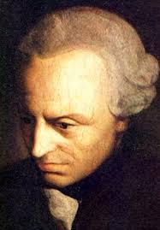
Summary& Kingdom of Ends Formulation
Kant’s Categorical Imperative

Slide 9
Big picture
Formula of Universal Law
Objections
“Act only according to that maxim by which you can at the same time will that it should become a universal law of nature.”
Rigorism
Sneaky Maxim Maker / Vacuous
Covert Consequentialism

Slide 10
Big picture
Formula of Universal Law
Question
“Act only according to that maxim by which you can at the same time will that it should become a universal law of nature.”
What are the rational will’s wider purposes?

Slide 11
Big picture
Formula of Humanity
Objections
“Act so that you treat humanity, whether in your own person or in that of another, always as an end and never as a means only.”
How do you respect the ends of others?
Moral Standing Objection

Slide 12
Big picture
The Kingdom of Ends
Kant’s CI
“So act as if you, by your own maxims, were at all times a legislative member in the universal realm of ends.”
Kingdom of ends
“A systematic union of rational beings by common objective laws.”
Self-Legislation
We, as rational agents, legislate the law to which we are subject.
Co-Legislation
Our maxims must be consistent with “the idea of the will of every rational being as a will giving universal law.”

Slide 13
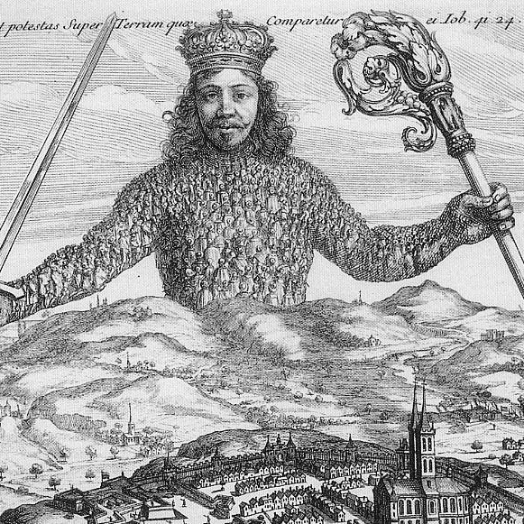
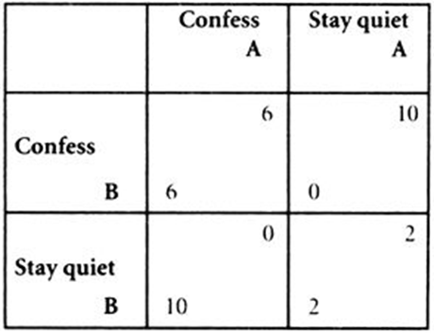
State of Nature
Individually rational to not cooperate
Collectively rational to cooperate

Slide 14
We are rationally required to leave the state of nature and submit to a coercive authority in order to adjudicate between conflicts of individual interests.

Slide 15
Rationality
Autonomous or Heteronomous?

Slide 16
Kant’s Categorical Imperative
Strongly Agree
Agree
Somewhat Agree
Neutral
Somewhat Disagree
Disagree
Strongly Disagree

Slide 17

Context for Sexual Ethics
Thomas Mappes,
“A Liberal View of Sexual Morality and the concept of Using Another Person”
Moralism
Conservatism
Liberalism

Slide 18
General approaches to sexual ethics
Moralism
Conservatism
Liberalism
Topics in Sexual Ethics
Masturbation
Sodomy & Oral Sex
Premarital sex
Homosexuality
Sexual Fetishes, e.g., BDSM, Body Modifications
Adultery
Deception, coercion, exploitation (Mappes)
Other areas in ethics:
Biomedical
Social-Political
Pornography and Censorship

Slide 19
Moralism in sexual ethics
Moralism argues that some things may be wrong even if there is no non-consenting person that is harmed.
Also called: harmless wrongdoing, e.g.
Some forms of pornography
Some forms of bestiality and incest
Some forms of consensual cannibalism
Notes:
These are disgusting - that’s the point. Now: it’s time to talk about sex, since that’s where many of us start to feel these emotions.

Slide 20
Conservative sexual ethics
Conservatism isn’t one sort of argument, but many; what links them is some space for moralism as a ground for prohibition
Edmund Burke grounds conservative thought in the limited power of human reason, in face of the wisdom of tradition
Lord Patrick Devlin, grounds it in the need for social unity
The Catholic Church grounds it in the natural purposes found in God’s creation

Slide 21
Liberal sexual ethics
Like conservatism, liberalism is a family of theories.
Rejection of moralism.
“Mill … argued that ‘the burden of proof is supposed to be with those who are against liberty; who contend for any restriction or prohibition…. [the] assumption is in favour of freedom…’” <http://plato.stanford.edu/entries/liberalism/>

Slide 22
We still need an ethical theory to justify claims about topics in sexual ethics, regardless of whether those claims are moralistic, conservative or liberal.
Topics in Sexual Ethics
Masturbation
Sodomy & Oral Sex
Premarital sex
Homosexuality
Sexual Fetishes, e.g., BDSM, Body Modifications
Adultery
Deception, coercion, exploitation (Mappes)
Other areas in ethics:
Biomedical
Social-Political
Pornography and Censorship

Slide 23
Preferred ethical theory to apply to topics in sexual ethics?
BenTham’s Hedonistic Utilitarianism
Mill’s Harm Principle
Natural Law Theory
Kantian Ethics
Other

Slide 24
Humanity Formulation
“Act so that you treat humanity, whether in your own person or in that of another, always as an end and never as a means only.”

Slide 25
Humanity Formulation
Interpretations:
Personal Tone
Actual Consent
Hypothetical Consent
Possible Consent
*From Onora O’Neil

Slide 26
Humanity Formulation
Interpretations:
Personal Tone
Actual Consent
Hypothetical Consent
Possible Consent
*From Onora O’Neil

Slide 27
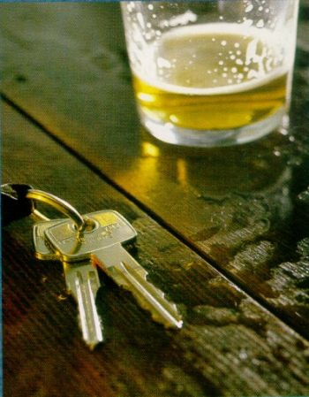
Autonomy Objection
The principle assumes that the morality of our actions depends only on what we can autonomously control, but the existence of moral luck calls this into question.
Moral luck: cases in which the morality of an action depends on factors outside of our control.

Slide 28
Autonomy Objection
The principle assumes that we are genuinely autonomous, but that assumption may be false.
Either our choices are necessitated, or they are not.
If they are necessitated, then they are out of our control, and so we lack autonomy.
If they are not necessitated, then they are random, and so we lack autonomy.
Therefore, we lack autonomy.

Slide 29
Mappes' main principle of sexual morality
“A sexually uses B if and only if A intentionally acts in a way that violates the requirement that B's sexual involvement with A be based on B's voluntary informed consent.”

Slide 30
Analyze the case
“Mr. Supervisor makes a series of increasingly less subtle sexual overtures to Ms. Employee. These advances are consistently and firmly rejected by Ms. Employee. Eventually, Mr. Supervisor makes it clear that the granting of ‘sexual favors’ is a condition of her continued employment.”

Slide 31
Analyze the case
“Ms. Debtor borrowed a substantial amount of money from Mr. Creditor, on the understanding that she would pay it back within a year. In the meantime, Ms. Debtor has become increasingly sexually attracted to Mr. Creditor. At the end of one year, Mr. Creditor asks Mr. Debtor to return the money. She says she will be happy to return the money so long as he consents to sexual interactions with her.”

